Slide 1

70 East Lake Street Suite 1700 Chicago, IL 60601 www.ctbaonline.org
Gentrification and Property Tax Exemptions in the City of Chicago
October 2, 2020

Slide 2
NHS Client Profile
Median annual income of $61,980
$200,000 as the average home value
$2,000 in annual property taxes for a typical NHS client
~1% of home value
Less than 4% of annual income

Slide 3
Longtime Homeowner exemptions Requirements
10 + years as principal residence or who, or at least 5 years if that person received assistance as part of a government or nonprofit program
Household income of $100,000 or less
“Adjusted Homestead Value”: the lesser of the following property’s base homestead value increase
10% increase for each year after the base year for qualified taxpayers with a household income ranging [$75,000, $100,000]
7% increase for each year after the base year for qualified taxpayers with a household income of $75,000 or less, or
The property's equalized assessed value for the current tax year minus the general homestead deduction

Slide 4
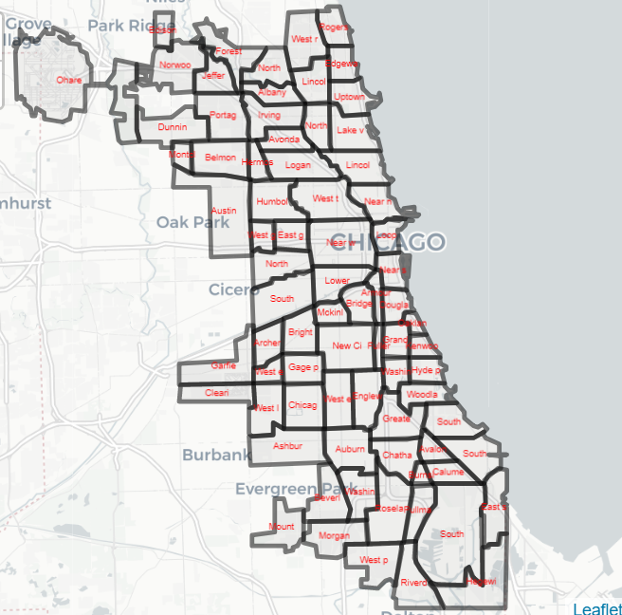
City of Chicago by Community Area

Slide 5
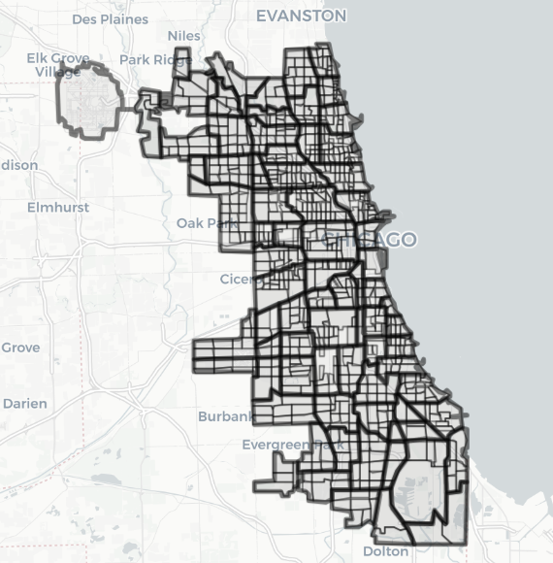
City of Chicago by Census Tract

Slide 6
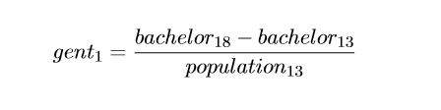
First Gentrification Definition
Restricted for tracts with household incomes below the median in 2013 ($58,676)
Identified tracts that experienced large positive changes (75th and 90th percentiles) in population aged+25 with a Bachelor Degree or Higher
Large positive changes in this variable were strongly correlated with outcomes representative of gentrification

Slide 7
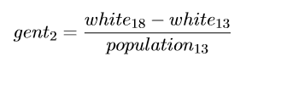
Second Gentrification Definition
Restricted for tracts with household incomes below the median in 2013 ($58,676)
Identified tracts that experienced large positive changes (75th and 90th percentiles) in white non-Latino population
Large positive changes in race demographics similarly correlated with outcomes representative of gentrification

Slide 8
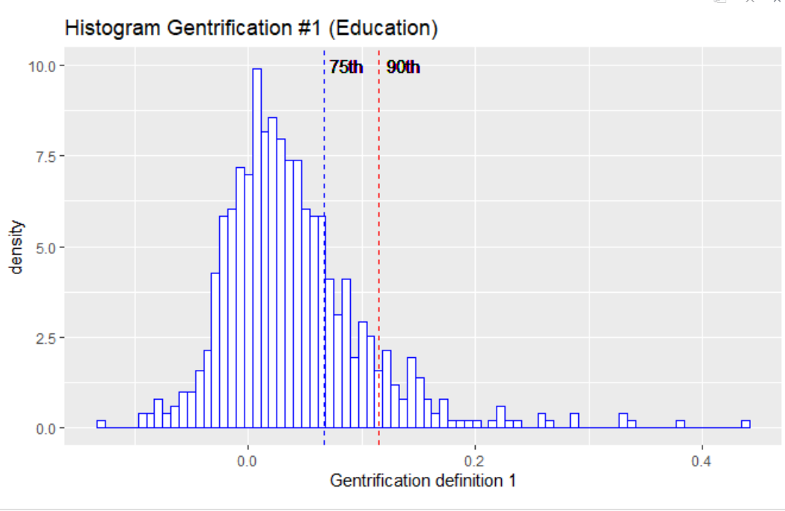
Distribution of Gentrification Definition #1

Slide 9
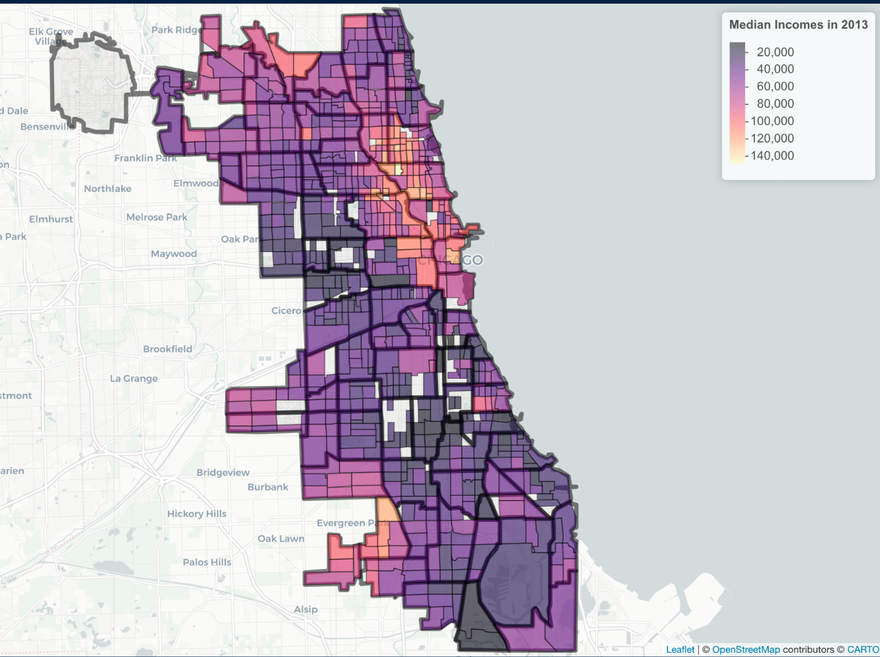
Median Household Income by Tracts (2013)

Slide 10
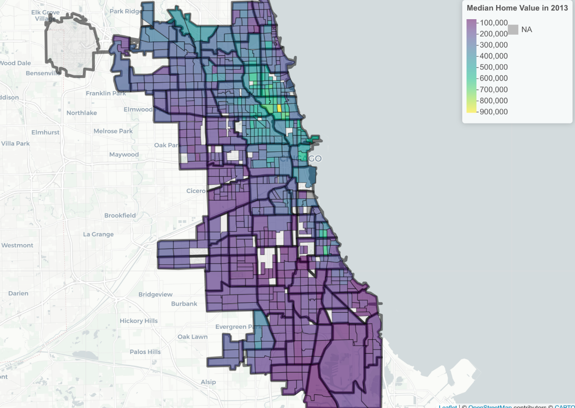
Median Home Value by Tracts (2013)

Slide 11
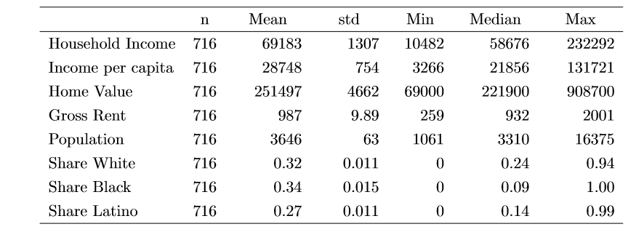
Snapshot of Chicago (2013)

Slide 12
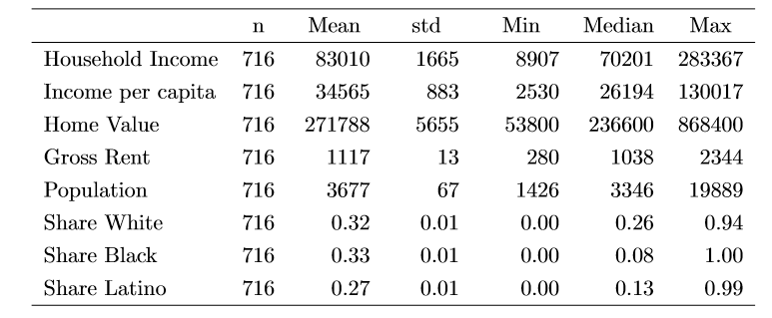
Snapshot of Chicago (2018)

Slide 13
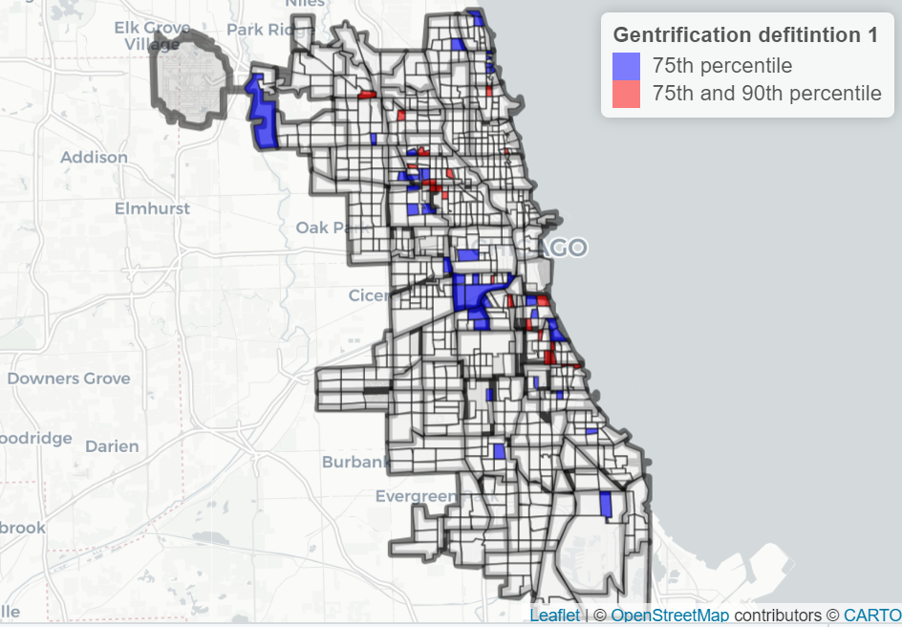
Under Definition #1, Gentrification Clustered in 3 Distinct Areas

Slide 14
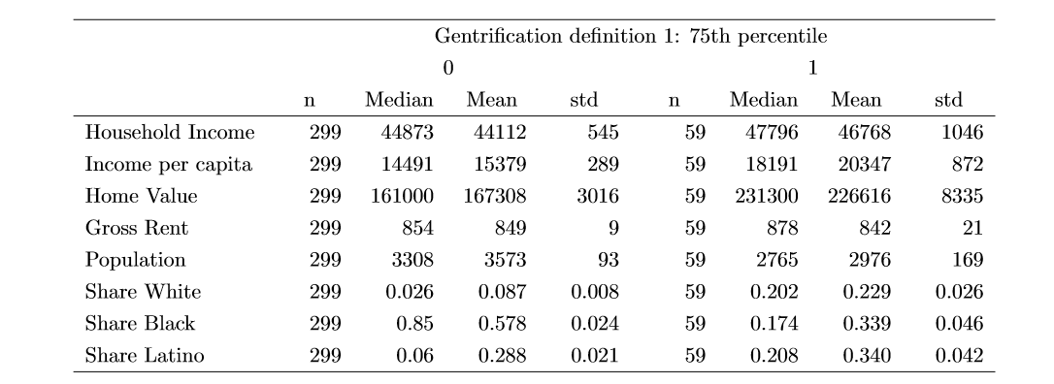
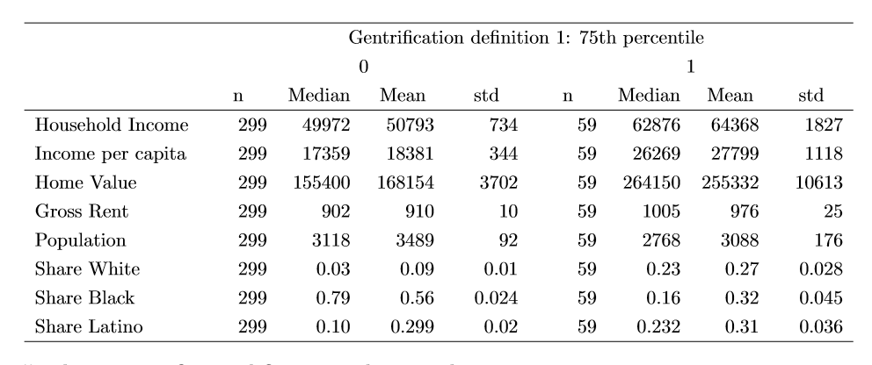
At the 75th percentile, Gentrified Tracts Outpaced Non-Gentrified Tracts
2013
2018

Slide 15
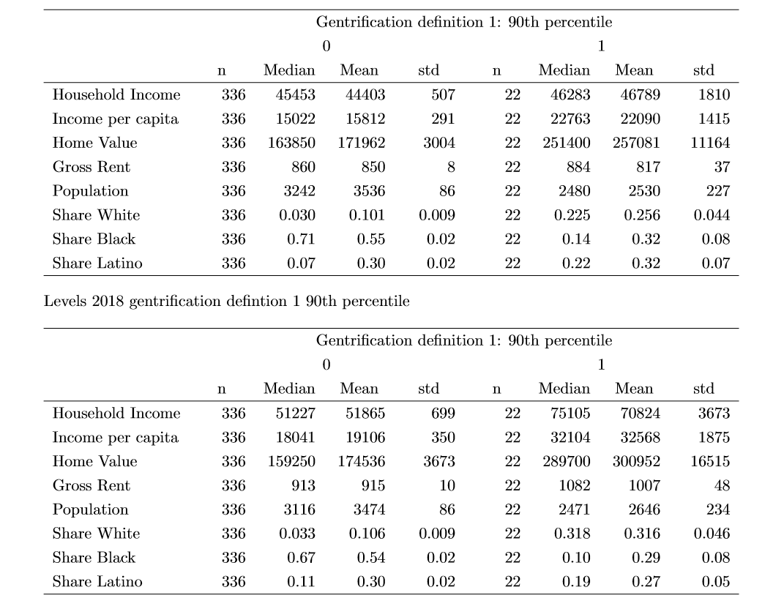
At the 90th percentile, Prior Trends Were Intensified
2013
2018

Slide 16
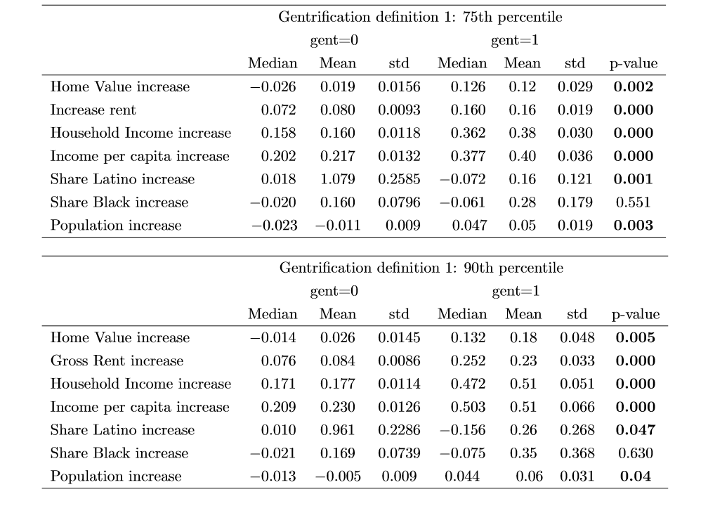
Gentrification Impacts Were
Intense and Statistically Significant

Slide 17
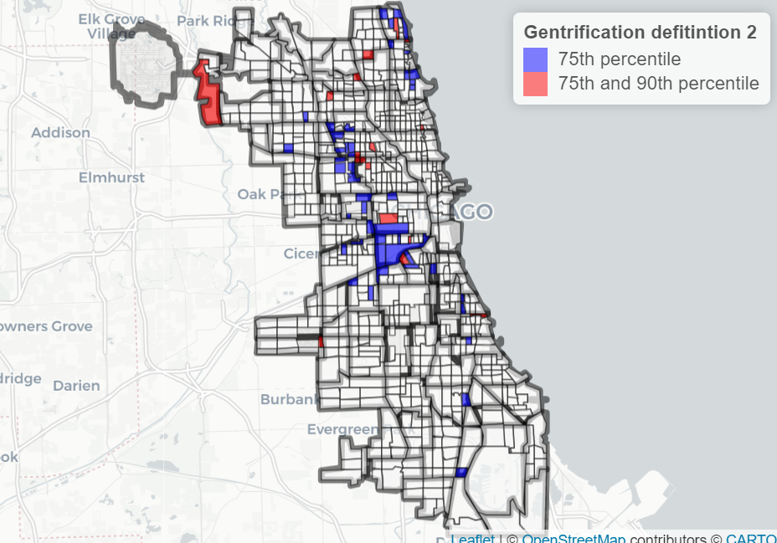
Under Gentrification Definition #2 Similar Clusters Appeared, Barring the South Side

Slide 18

Similar Trends Emerge Under Definition #2
2013
2018

Slide 19
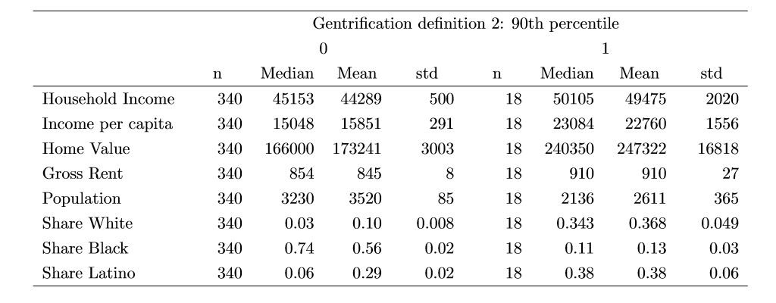
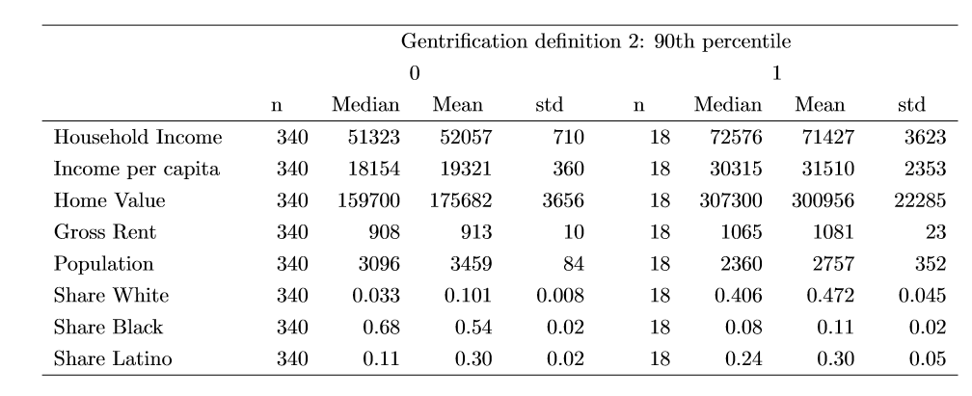
With Similar Growth in Intensity at the 90th Percentile
2013
2018

Slide 20
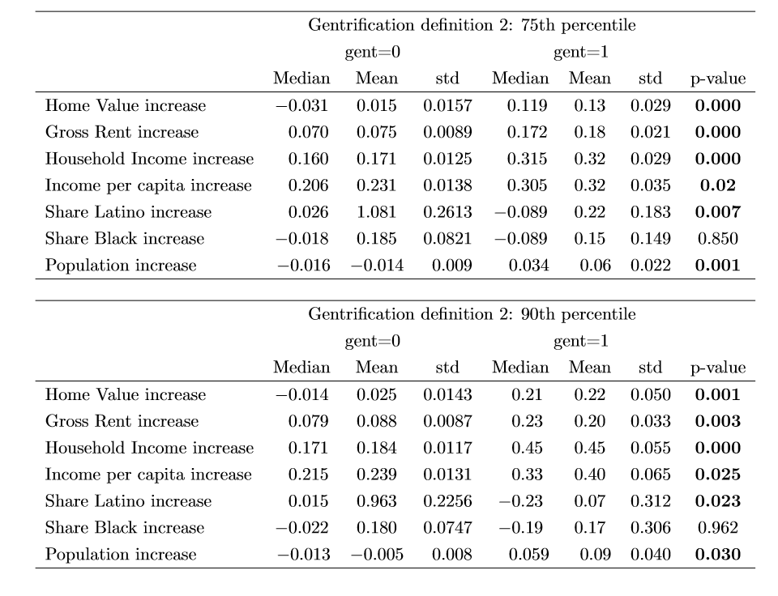
Result Still Retaining Statistical Significance

Slide 21
Characteristics of Gentrifiable Areas
Initially, gentrifiable tracts are typically less populated
More likely to occur in tracts with a higher share of the Latino population
Typically have slightly higher income and home values
Median and mean rents are similar

Slide 22
Under Definition #1, Median Household Income Grew Faster In Logan Square

Slide 23
Under Definition #1, Median Home Value Growth Exhibited Similar Trends

Slide 24
Comments on summary statistics for changes in outcomes under definition 1
Home values, rents, income, and population increase significantly in gentrified tracts
Gentrification occurs mainly in Latino tracts and neighborhoods
Share of black or African American individuals decline in both gentrified and not gentrified tracts
Home values increased between 12% and 18%, and rents increased between 16% and 23% in gentrified tracts between 2013 and 2018

Slide 25
Increase in median income under defition #2 at the 75th percentile

Slide 26
Increase in home values under definition #2 at the 75th percentile

Slide 27
Comments on summary statistics under def #2
Home values, rents, income, and population increase significantly in gentrified tracts according to definition 2
Gentrification locates significantly more in Latino tracts.
Home values increase on average between 13% and 22%, and rents increase between 18% and 20% in gentrified tracts

Slide 28
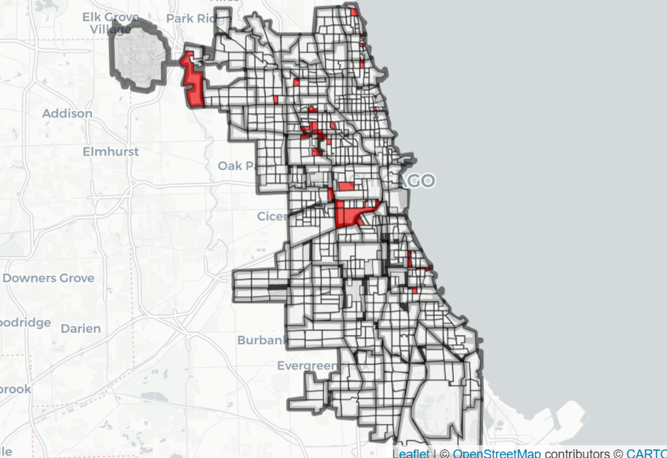
Gentrified Tracts under both definitions at the 75th percentile

Slide 29
Recommendations for legislation
Reduce $100,000 requirement for the AMI ($81,900 April 2020 for household size of 3)
Reduce $75,000 requirement for the 80% AMI ($65,550 April 2020 for household size of 3)
Reduce increase in home value requirement from 10% to 5% (26% increase over 5 years)
Reduce increase in home value requirement from 7% to 3% (16% increase over 5 years)

Slide 30
For More Information
Drazzel Feliu
Research Director, Center for Tax and Budget Accountability
(312) 332-2151
dfeliu@ctbaonline.org
Fernando Garcia
Research Intern, Center for Tax and Budget Accountability and
MPP Candidate at Harris School of Public Policy
(312) 866-2886
garciaf@uchicago.edu
.
CTBA's principal goal is to ensure major policy systems work to promote social and economic justice. You can help strengthen our efforts by making a tax-deductible donation at www.ctbaonline.org/donate

